Slide 1
Enhanced Course Enrollment and Notification System
Team Name: Digital Catalysts Team Members: Kumbam, Sai Sri Harsha Martha, Harshith Nagabhyrava, Jaswanth Ram

Slide 2

System Proposal
Streamlined Enrollment: Redesign process, intuitive, UMBC goals.
Enhanced Engagement: Automated alerts, user-friendly, efficient admin.

Slide 3
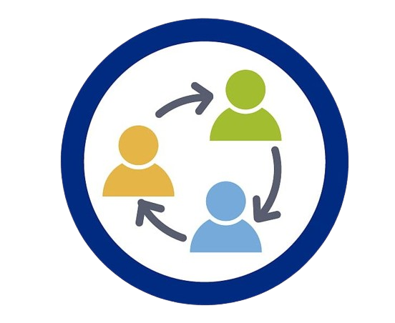



Key Features
Automated Waitlist Management
Cross-Departmental Registration
Real-Time Notifications
User Dashboard

Slide 4
Organizational Benefits
Improved Student Satisfaction
Improved Data Correctness
Assistance in Making Strategic Decisions
Scalability & Flexibility
Enhanced Administrative Efficiency

Slide 5

System Architecture and Design
Software Development
Testing and Quality Assurance
Analysis
Phased Rollout and Training

Slide 6

Economic Feasibility Analysis
Cost
Development Expenditure, Maintenance, Training
Benefits
Enhanced Efficiency, Improved Student experience

Slide 7
Technical Feasibility Analysis
Database Systems
API Development & Integration tools
User Interface
Notification Systems
Technical Expertise

Slide 8

Organizational Feasibility Analysis
Implementation Time
Politics
Legal Concerns
Change Management
Risk & Limitations

Slide 9

Alternatives
Solution-1: Enhanced Administrative Process
Solution-2: Third-Party Enrollment Services
Criterion-1: Time Management
Criterion-2: Student Satisfaction
Criterion-3: Error Handling
Criterion-4: Cost
Criterion-5: Adaptability

Slide 10
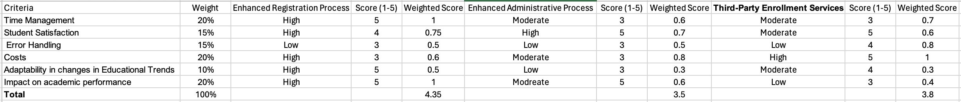
Alternative Matrix

Slide 11
THANK YOU
QUESTIONS?

